Slide 1


Course Title :
Computer Network
Presented By:
Md. Ahadul Haque
IT-18045
&
Ali Ashadullah Arif
IT-18031
Dept. Of ICT
MBSTU
Presented To:
Nazrul Islam
Assistant Professor
Dept. of ICT
MBSTU
1

Slide 2
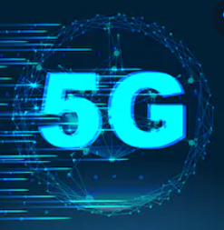
Presentation Topic:
5G Network

Slide 3
Topics To Be Covered :
1. Introduction to 5G.
2. Evolution from 1G to 5G.
3. Key Concept.
4. Hardware & Software of 5G.
5. features.
6. Advantages.
7. Applications.
8. Conclusion.

Slide 4
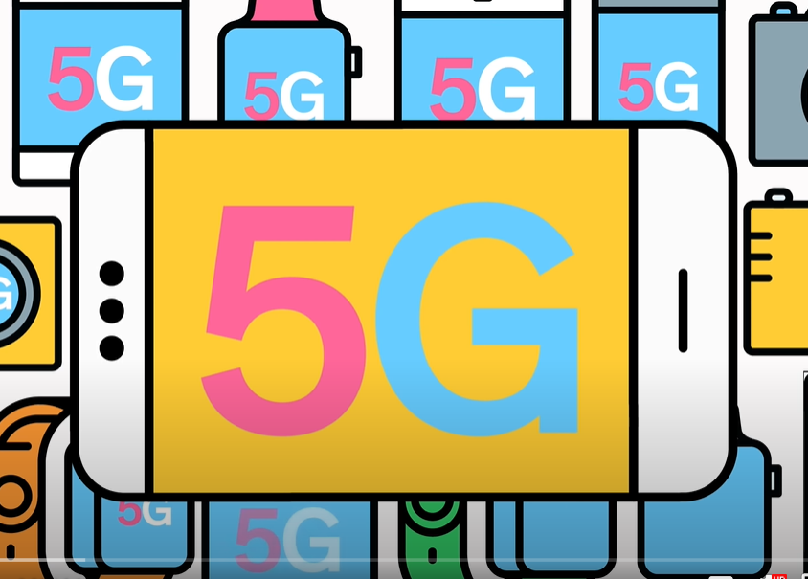
Introduction To 5G
What Is 5G ?
What Does It Offer?

Slide 5
What Is 5G ?
∙ 5G stand for 5th generation wireless technology.
∙ Complete Wireless communication with almost no limitations.
∙ Can be called Real wireless world.
∙ Has incredible transmission speed.

Slide 6
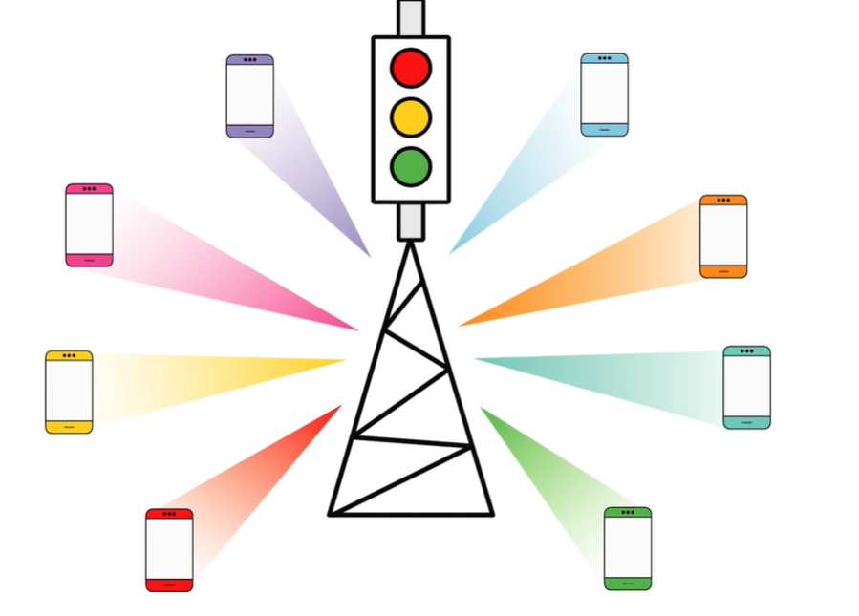
What Does It Offer?
∙ Worldwide cellular phones.
∙ Extraordinary data capabilities.
∙ High connectivity.
∙ More power & features in hand held phones.
∙ Large phone memory , more dialing speed, more clarity in audio & video.

Slide 7
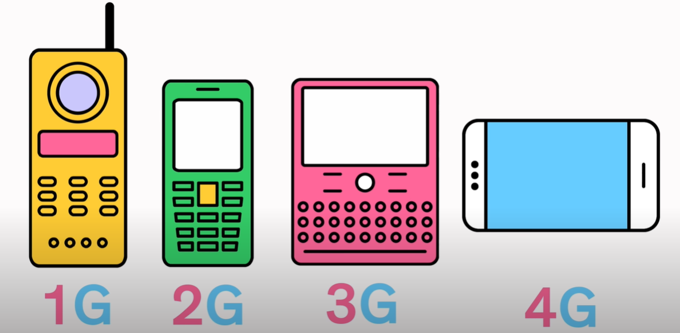

Evolution from 1G to 5G.
∙ 1G
∙ 2G
∙ 3G
∙ 4G
∙ 5G
5G

Slide 8
Key Concept
Real wireless world with no more limitations with access & zone issues .
Wearable devices.
IPv6 , where a visiting care of mobile IP address is assigned according to location & connected network.
One unified global standard.
Smart radio.
Multiple Concurrent data transfer path.

Slide 9
Hardware Of 5G
5G Hardware
Uses Uwb (Ultra wide band) networks with higher BW at low energy levels.
BW is of 4000 Mbps, which is 400 times faster than today’s wireless networks.
Uses smart antenna.
Uses CDMA (Code Division Multiple Access).

Slide 10
Software Of 5G
5G will be single unified standard of different wireless networks, including LAN technologies, LAN/WAN , WWWW – World Wide Wireless Web, unified IP & Seamless combination of broadband.
Software defined radio, encryption, Anti – virus.
High resolution for crazy phone users.

Slide 11
Features Of 5G
High resolution for crazy cell phone users.
Bi – directional large BW.
Less traffic.
25 Mbps connectivity speed.
Enhanced & available connectivity just about the world.
Uploading & Downloading speed of 5G touching the pack(up to 1 Gbps).
Better & fast solution.
Support virtual private networks.
High quality service based on policy to avoid error.

Slide 12
Advantage Of 5G
Data BW of 1 Gbps of higher.
Globally accessible .
Dynamic information access.
Available at low cost.
Easily manageable with the previous generations.
Most likely, will provide a huge broadcasting data (in Gigabit), which will support more than 60,000 connections.

Slide 13
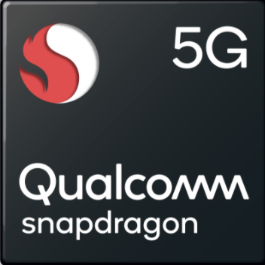
Application Of 5G
Wearable devices with AI(Artificial Intelligence) capabilities.
Global networks.
Media independent handover.
Radio resource management.
VoIP (Voice ove IP) enabled devices.
With 6th sense technology.

Slide 14

Bonus Topic: 5G and Our Country.
Only six percent of the total mobile network users of Bangladesh in 2025 will enjoy Fifth Generation (5G) internet services, according to global mobile communication industry GSM Association (GSMA).
According to the latest Asia Pacific edition of the GSMA Mobile Economy series, released on Monday, countries like Bangladesh, India, Indonesia, and Pakistan still have vast room to develop 4G networks while the 5G opportunity is longer term.

Slide 15
Conclusion
3G – Operator Centric.
4G – Service Centric Whereas
5G – User Centric.
We have proposed 5G wireless concept designed as an open platform on different layers.
The new coming 5G technology will be available in the market at affordable rates, high peak future & much reliability than preceding technologies.

Slide 16




Slide 17


